Slide 1
Deterministic SIR models: Overview and the epidemic model
Cristina Lanzas and Shi Chen
CBS 810 Infectious disease modeling

Slide 2
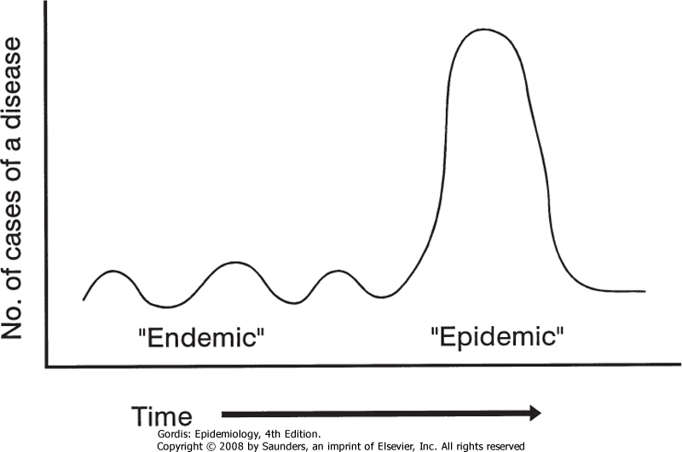
Epidemiological temporal patterns
Epidemic A rapid increase in the levels of an infection beyond what is expected for a given time and place.
Endemic: levels of infection do not exhibit wide fluctuations through time in a defined place.
Notes:
Temporal pattern/dynamics: probably the most obvious and important aspect of infectious disease.

Slide 3
Learning objectives
Derive the epidemic SIR model
Explain the different approaches used to describe the ‘transmission term’
Describe the basic insides on infectious disease dynamics provided by the epidemic SIR model.

Slide 4
Prelude: An SI Difference Equation
St: Number of Susceptible at time t
It: Number of Infected at time t
St+It=N (constant population size)
Difference Equation (Discrete time and state)
St+1=St-βStIt
It+1=It+ βStIt
S->I
Some mathematical magic…
dI/dt= βSI
Notes:
Analytical solution: exponential curve w/upperbound
Qualitative study: S->0 and I->N.
How about SIS model? Some equilibrium/steady state?

Slide 5
Compartmental models

Slide 6
Epidemic models: To describe fast outbreaks, only the flows related to the infection are considered.
S
I
R
Transmission
Recovery
Endemic models: To describe infection over a long time period, the flows related to demographic changes are also considered.
Births
S
I
R
Transmission
Recovery
Deaths
Deaths
Deaths
Notes:
Discuss endemic next time. SIR: foundation of most epi-models.

Slide 7
Epidemic SIR model
S
I
R
Transmission
Recovery
dS/dt= - transmission
dI/dt= + transmission- recovery
dR/dt= + recovery
Notes:
Processes: each arrow is a process; inflow is plus, outflow is minus. How we first translate a real epi- problem into graphical model, then use mathematical language to describe the graphical model.

Slide 8
Modes of transmission
Touching
Sexual intercourse
Biting
Direct projection of droplets
Transplacenta
Direct transmission
(host-to-host)
Indirect transmission
Airborne
Vehicle-borne
Vector-borne
Notes:
Process one: transmission (from infectious to susceptible)

Slide 9
Transmission for contact-based transmitted diseases
Contact between individuals in the population (c)
Probability that a given contact is with an infected individual (p)
p = I / N
Probability that a contact with an infected individual results in a successful transmission (v)

Slide 10

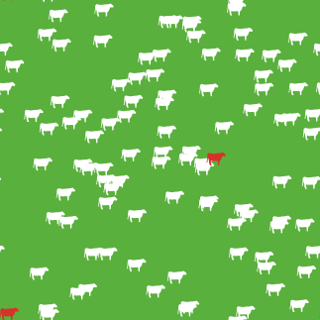
Is contact rate dependent on population density?
Density-dependent contacts: c = kN/A
Frequency-dependent contacts: c = n

Slide 11
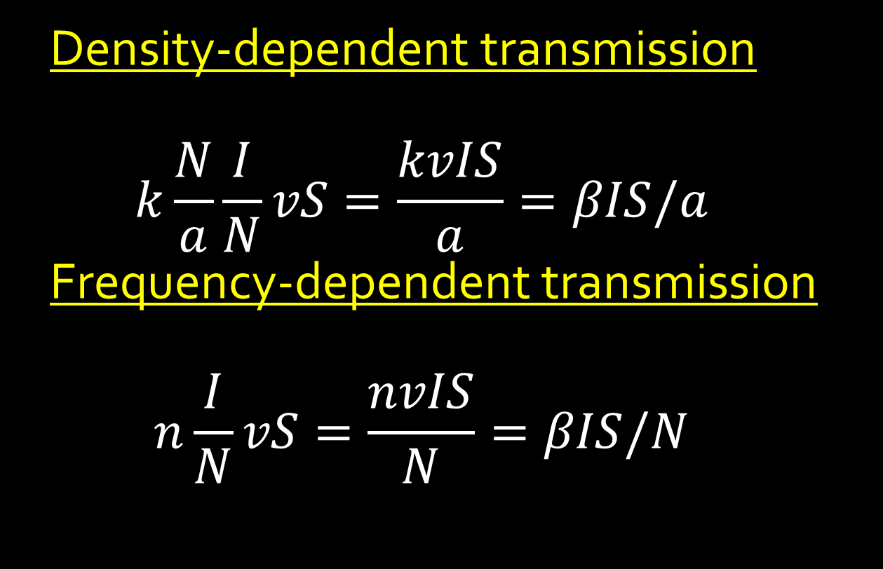
Transmission for contact-based transmitted diseases
Density-dependent transmission
$$k\frac{N}{a}\frac{I}{N}vS=\frac{kvIS}{a}=βIS/a$$
Frequency-dependent transmission
$$n\frac{I}{N}vS=\frac{nvIS}{N}=βIS/N$$
Notes:
a is a constant; usually combine with beta. N is population size. To offset the influence of population size we need to divide transmission with N in frequency-dependent transmission scenario (a bit confusing, but need some reasoning!)

Slide 12
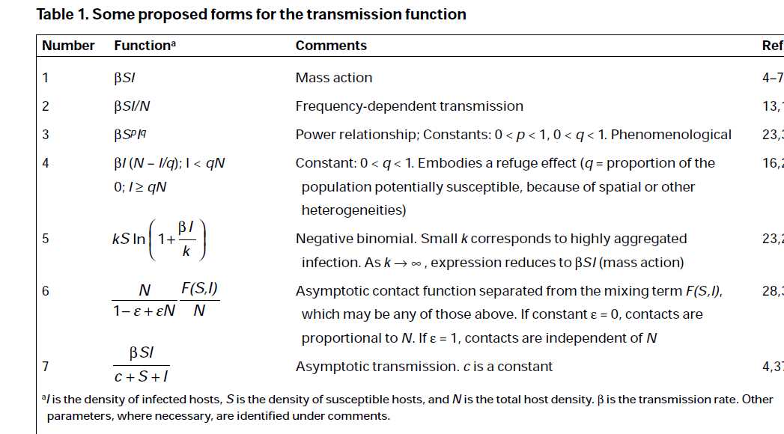
= Density-dependent transmission
McCallum et al. Trends Ecol Evol 16: 295-300 (2001)

Slide 13
Recovery
We often assume that the recovery rate (γ) is constant (1/duration of the infectious period)
For a constant per capita rate of leaving compartment, the residence time in the compartment is exponentially distributed.
Notes:
Process 2: recovery (independent of contact. A fixed rate of recovery)

Slide 14
Epidemic SIR model
S
I
R
Transmission
Recovery

Slide 15
Epidemic SIR model

Slide 16




Initial growth of an epidemic

Slide 17


Initial epidemic growth & Basic reproduction number
$$\frac{dI}{dt}>0, epidemic will grow$$
$$\frac{dI}{dt}<0, epidemic will die out$$
In a fully susceptible population (S(0)=N)
dI/dt > 0 if βN/γ > 1 (grows)
dI/dt < 0 if βN/γ < 1 (dies out)

Slide 18
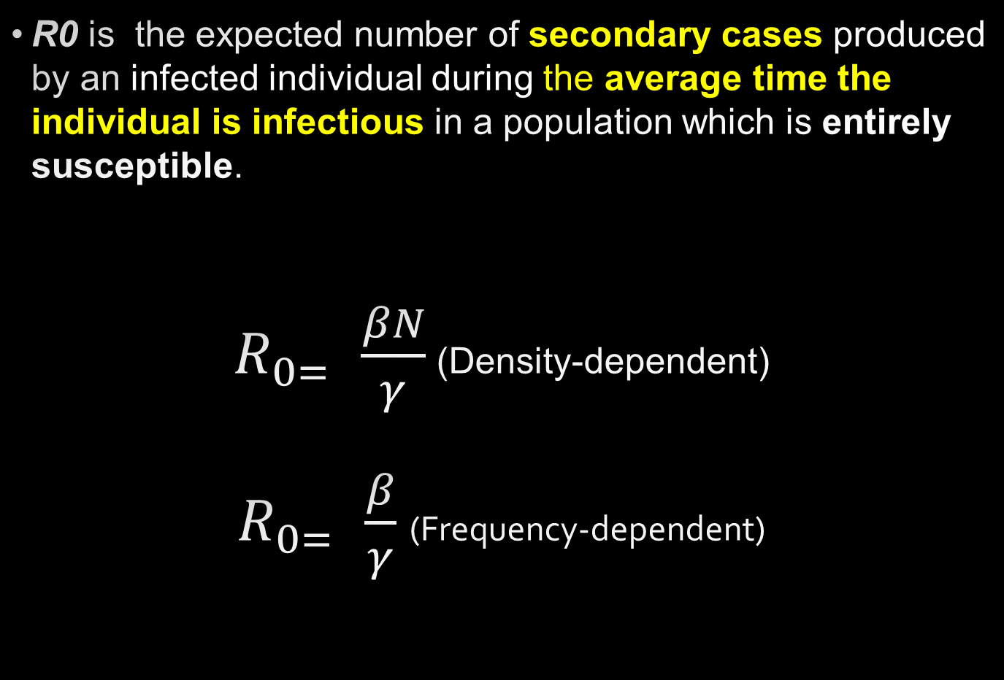
Basic reproduction number (R₀)
R0 is the expected number of secondary cases produced by an infected individual during the average time the individual is infectious in a population which is entirely susceptible.
$R_{0= }\frac{βN}{γ}$ (Density-dependent)
$R_{0= }\frac{β}{γ}$ (Frequency-dependent)

Slide 19
The critical vaccination proportion, pc
The critical vaccination proportion that will achieve eradication, p_{c,} is that for which the basic reproduction number under vaccination (R_{v}) is just equal to 1.
Scherer, A. & McLean, A. Mathematical models of vaccination. Br Med Bull 62, 187-199 (2002).

Slide 20
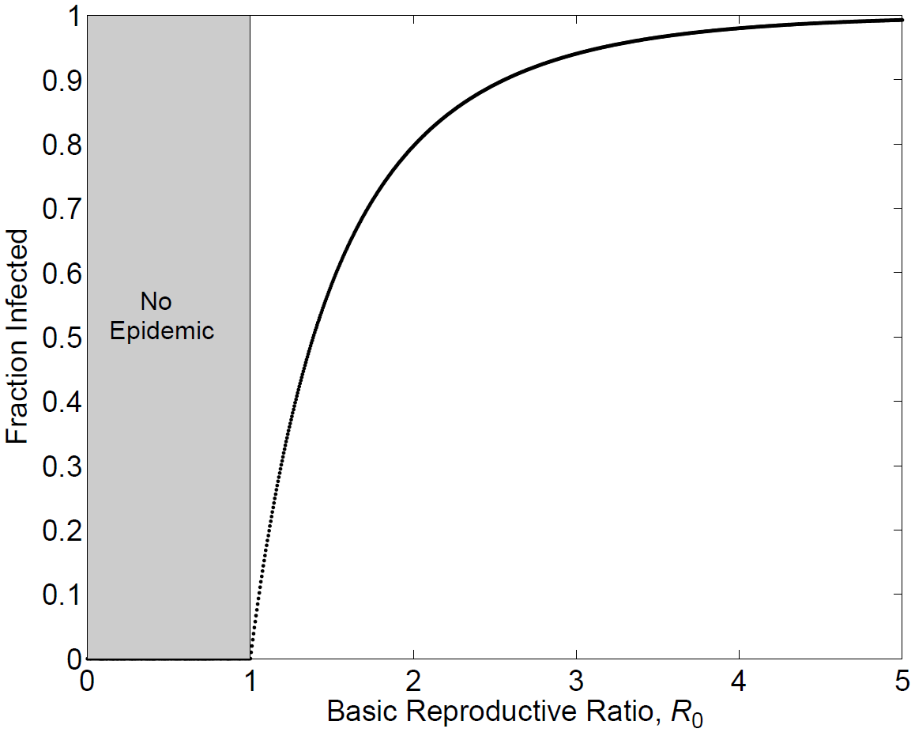
Fraction of infected population at the end of an epidemic is function of R0
Keeling and Rohani, Modeling inf dis in humans and animals 2008

Slide 21
Summary epidemic model
In a closed population, a pathogen with a given R₀ can only invade if there is a threshold fraction of susceptibles greater than 1/R₀.
Immunizing a proportion of the population equal or greater than 1-1/R₀ can prevent and/or eradicate the pathogen.
The fraction of the population that eventually becomes infected is a function of R₀.

Slide 22
Epidemic SEIR model
S
E
R
I
I
Notes:
Write down the equations (note the arrows)

Slide 23
Epidemic SEIR model

Slide 24
Readings
Chapter 2. Introduction to simple epidemic models (p15-p.24) in Keeling, M.J. & Rohani, P. Modeling infectious diseases in humans and animals, (Princeton University Press, Princeton, NJ, 2008).
Begon, M., Bennett, M., Bowers, R.G., French, N.P., Hazel, S.M., Turner, J., 2002. A clarification of transmission terms in host-microparasite models: numbers, densities and areas. Epidemiol Infect 129, 147-153.
Note: For Keeling and Rohani book, note the difference on notation, we will use S, I, R (capital) to denote numbers and s, i, r to denote proportions. Keeling and Rohani use S, I, R for proportions and X, Y, and Z for numbers.

